Slide 1
Contents
Transport Service
Elements of Transport Protocols
Internet Protocols – UDP
Internet Protocols – TCP
Congestion Control

Slide 2

The Transport Layer
Starting the Transport Layer!
– Builds on the network layer to deliver data across networks for applications with the desired reliability or quality
Application
Transport
Network
Link
Physical

Slide 3
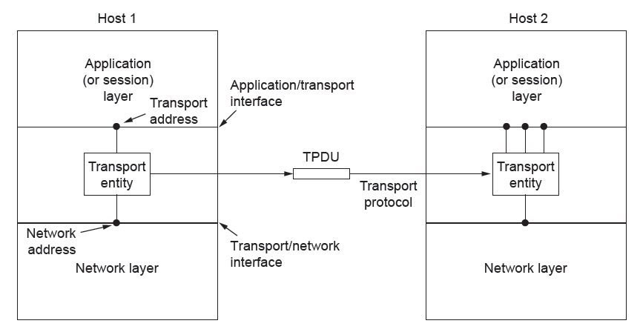
The Transport Layer
Transport layer adds reliability to the network layer
Offers connectionless (e.g., UDP) and connection-oriented (e.g, TCP) service to applications

Slide 4
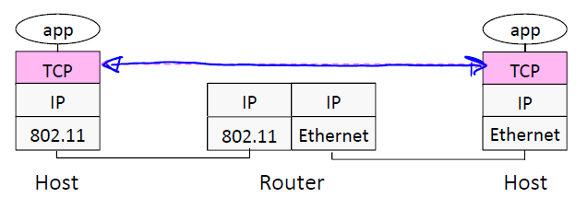
The Transport Layer
Transport layer provides end-to-end connectivity across the network

Slide 5
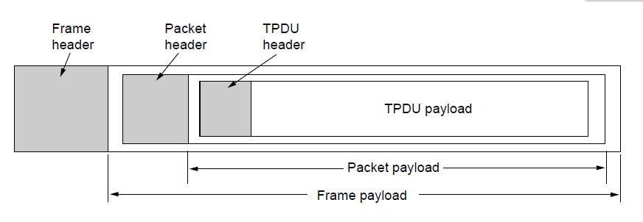
The Transport Layer
Transport layer sends segments in packets (in frames)
Segment
Segment

Slide 6
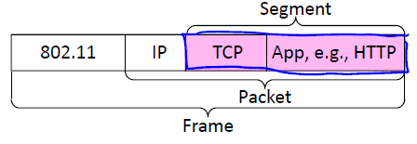
The Transport Layer
Segments carry application data across the network
Segments are carried within packets within frames

Slide 7
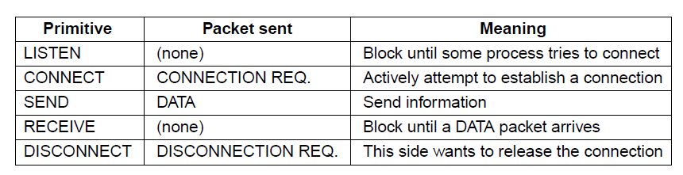
The Transport Layer
Primitives that applications might call to transport data for a simple connection-oriented service:
Client calls connect, send, receive, disconnect
Server calls listen, receive, send, disconnect
Segment

Slide 8
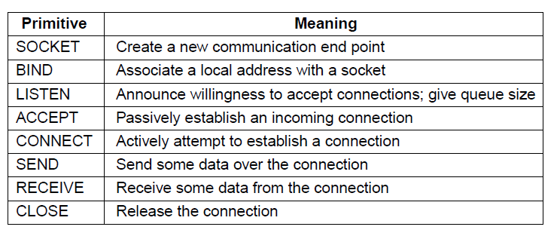
The Transport Layer
Berkeley Sockets
Very widely used primitives started with TCP on unix
Notion of “sockets” as transport endpoints
Like simple set plus socket, bind, and accept

Slide 9
Contents
Transport Service
Elements of Transport Protocols
Internet Protocols – UDP
Internet Protocols – TCP
Congestion Control

Slide 10
Connection Establishment
Key problem is to ensure reliability even though packets may be lost, corrupted, delayed, and duplicated
Don’t treat an old or duplicate packet as new
(Use ARQ and checksums for loss/corruption)
Approach:
Don’t reuse sequence numbers within twice the MSL (Maximum Segment Lifetime) of 2T=240 secs
Three-way handshake for establishing connection
Notes:
The MSL of 2 minutes is just an engineering bound that is conservative (and probably too high these days). Twice the MSL is used to ensure that neither a packet nor an acknowledgment for the packet can still be in the network.

Slide 11
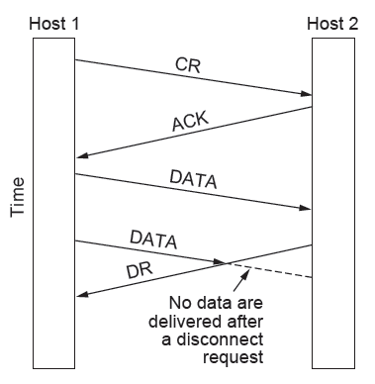
Connection Release
Key problem is to ensure reliability while releasing
Asymmetric release (when one side breaks connection) is abrupt and may lose data
X

Slide 12
Error Control and Flow Control
Foundation for error control is a sliding window (from Link layer) with checksums and retransmissions
Flow control manages buffering at sender/receiver
Issue is that data goes to/from the network and applications at different times
Window tells sender available buffering at receiver
Makes a variable-size sliding window

Slide 13
Contents
Transport Service
Elements of Transport Protocols
Internet Protocols – UDP
Internet Protocols – TCP
Congestion Control

Slide 14
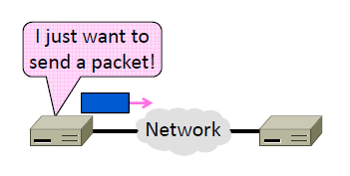
User Datagram Protocol
Sending messages with UDP
– A shim layer on packets

Slide 15
User Datagram Protocol
Used by apps that don’t want reliability or bytestreams
– Voice-over-IP (unreliable)
– DNS, RPC (message-oriented)
– DHCP (bootstrapping)
(If application wants reliability and messages then it has work to do!)

Slide 16
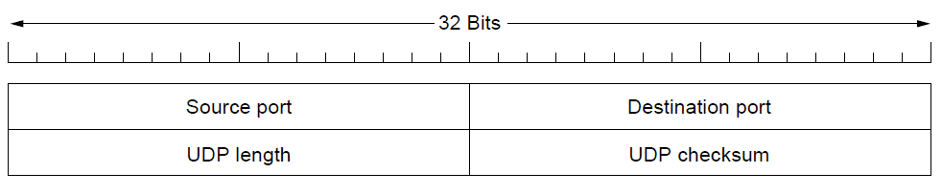
User Datagram Protocol
Uses ports to identify sending and receiving application processes
Datagram length up to 64K
Checksum (16 bits) for reliability

Slide 17
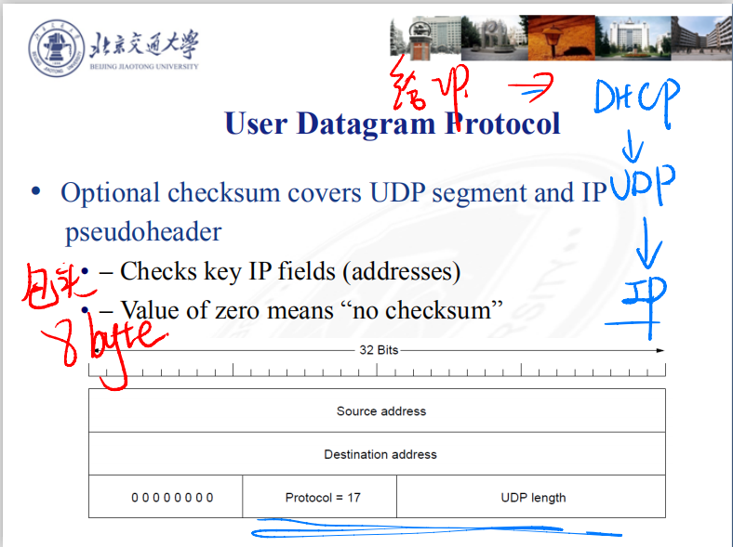
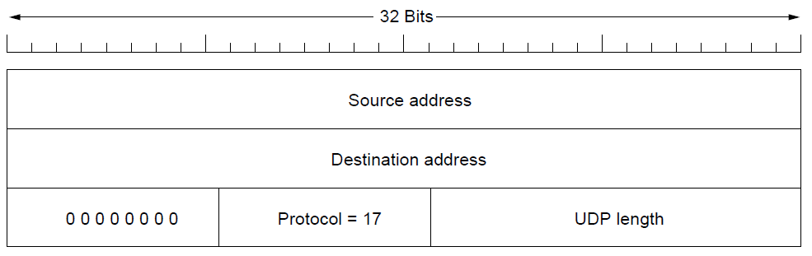
User Datagram Protocol
Optional checksum covers UDP segment and IP pseudoheader
– Checks key IP fields (addresses)
– Value of zero means “no checksum”

Slide 18
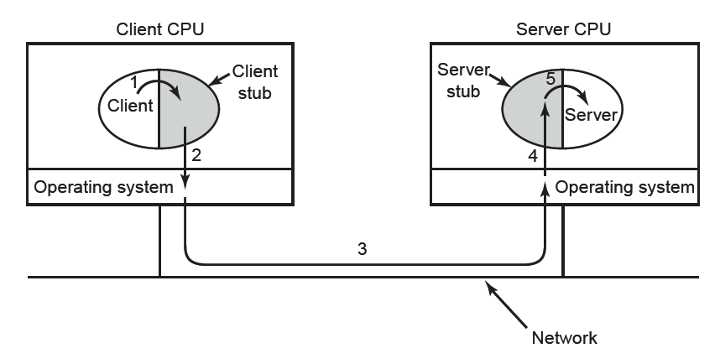
RPC (Remote Procedure Call)
RPC connects applications over the network with the familiar abstraction of procedure calls
Stubs package parameters/results into a message
UDP with retransmissions is a low-latency transport

Slide 19
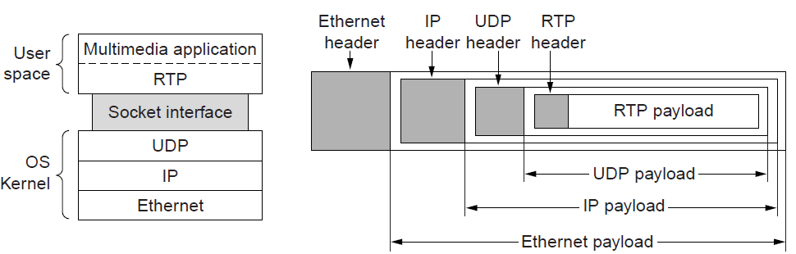
Real-Time Transport
RTP (Real-time Transport Protocol) provides support for sending real-time media over UDP
Often implemented as part of the application

Slide 20
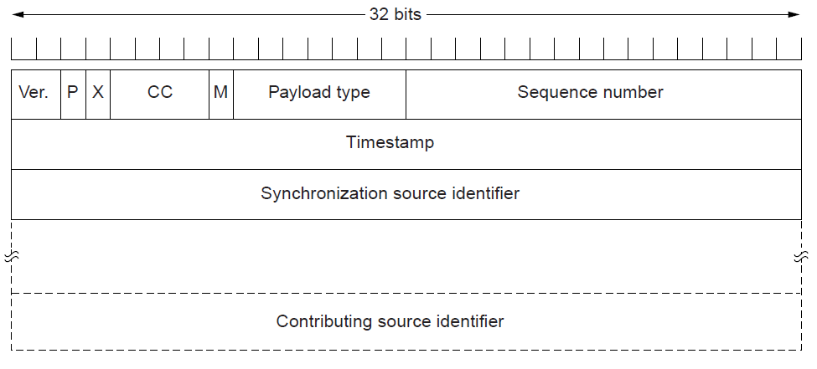
Real-Time Transport
RTP header contains fields to describe the type of media and synchronize it across multiple streams
RTCP sister protocol helps with management tasks

Slide 21
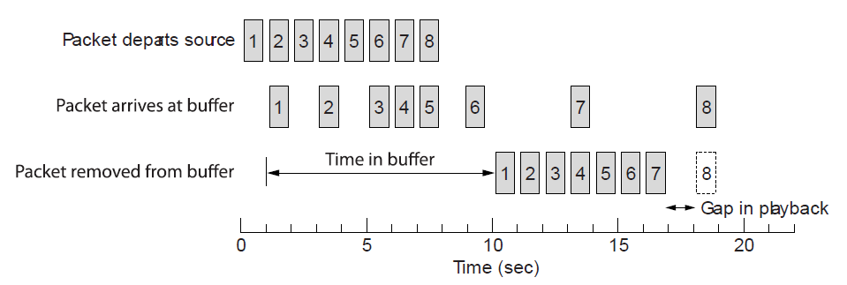
Real-Time Transport
Buffer at receiver is used to delay packets and absorb jitter so that streaming media is played out smoothly
Packet 8’s network delay is too large for buffer to help
Constant rate
Variable rate
Constant rate

Slide 22
rdt3.0: stop-and-wait operation
Sender
Receiver
first packet bit transmitted, t = 0
last packet bit transmitted, t = L / R
first packet bit arrives
RTT
last packet bit arrives, send ACK
ACK arrives, send next packet, t = RTT + L / R

Slide 23
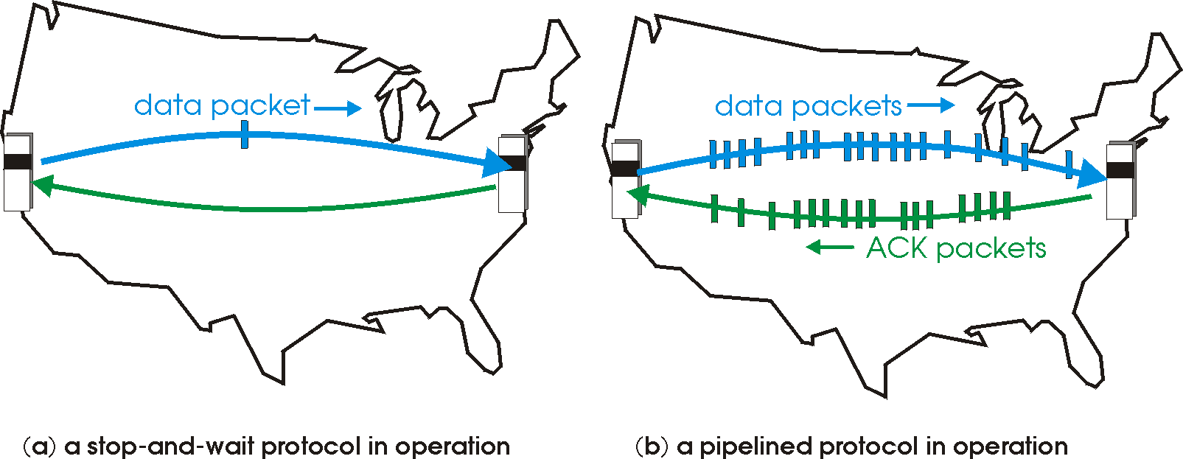
Pipelined Protocols
Multiple, “in-flight” Packets
Range of Seq #s
Buffering
2 Forms
Go-Back-N
Selective Repeat

Slide 24
Pipelining: Increased Utilization
Sender
Receiver
first packet bit transmitted, t=0
last bit transmitted, t = L / R
first packet bit arrives
RTT
last packet bit arrives, send ACK
last bit of 2nd packet arrives, send ACK
last bit of 3rd packet arrives, send ACK
ACK arrives, send next
packet, t = RTT + L / R

Slide 25
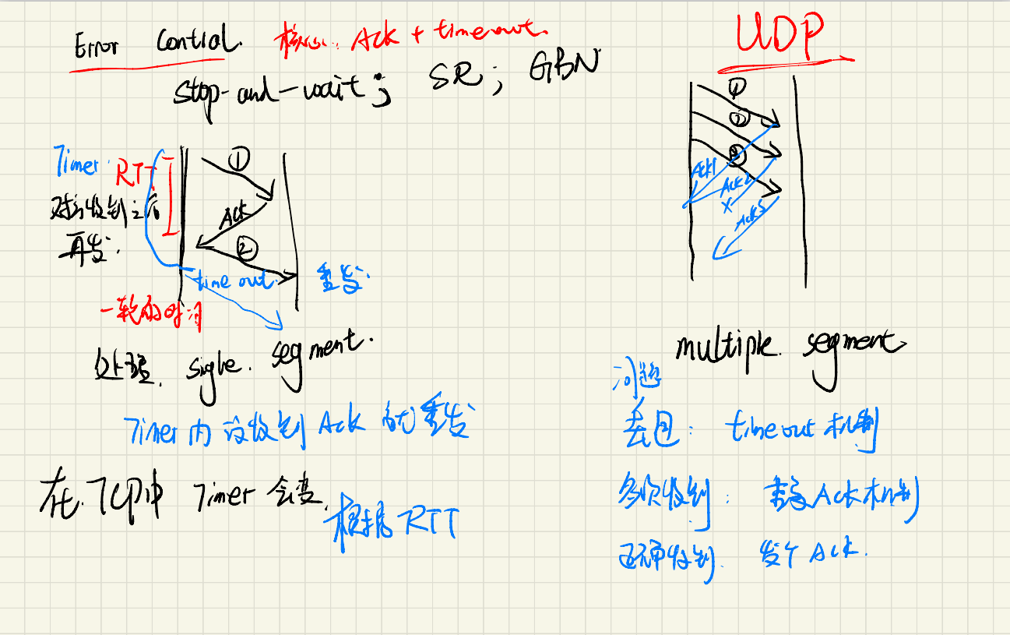

Slide 26
Pipelining Protocols: Overview
Go-Back-N
Selective Repeat
Sender
Up to N unACKed pkts in pipeline
Receiver
Only sends cumulative ACKs
Doesn’t ACK pkt if there’s a gap
Sender
Timer for oldest unACKed pkt
If timer expires, retransmit all unACKed packets
Sender
Up to N unACKed packets in pipeline
Receiver
ACKs individual pkts
Sender
Timer for each unACKed pkt
If timer expires, retransmit only unACKed packet

Slide 27
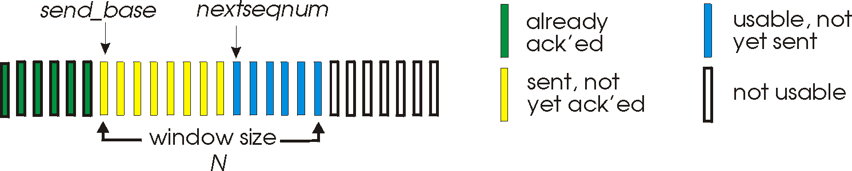
Go-Back-N

Slide 28
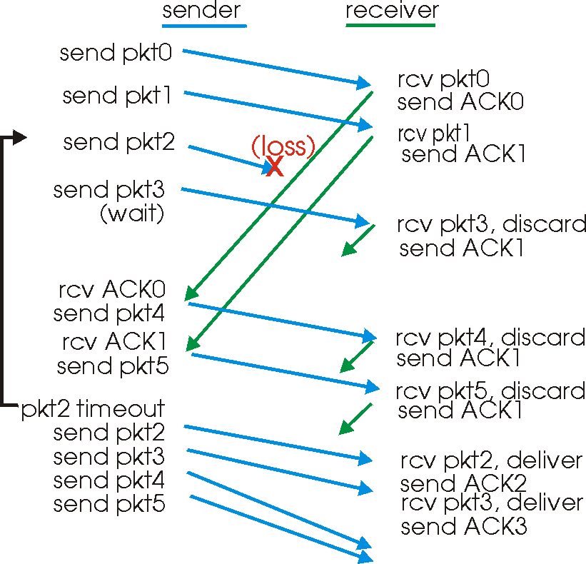
GBN

Slide 29
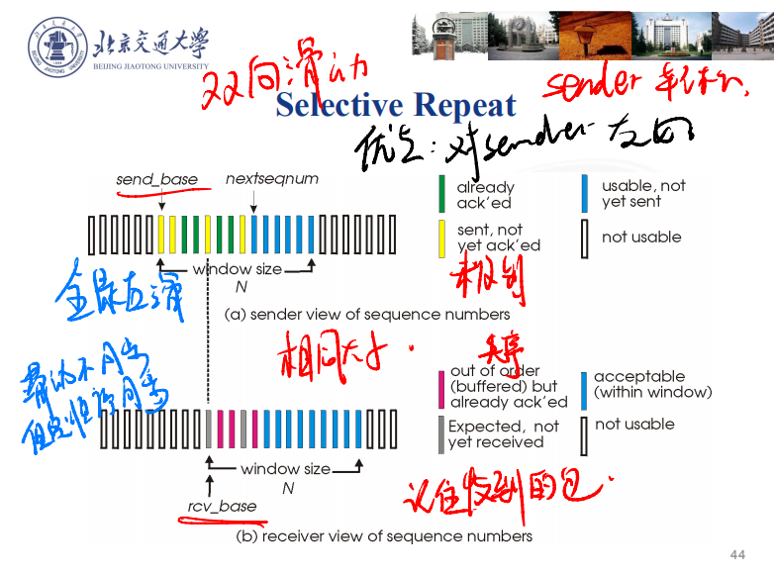
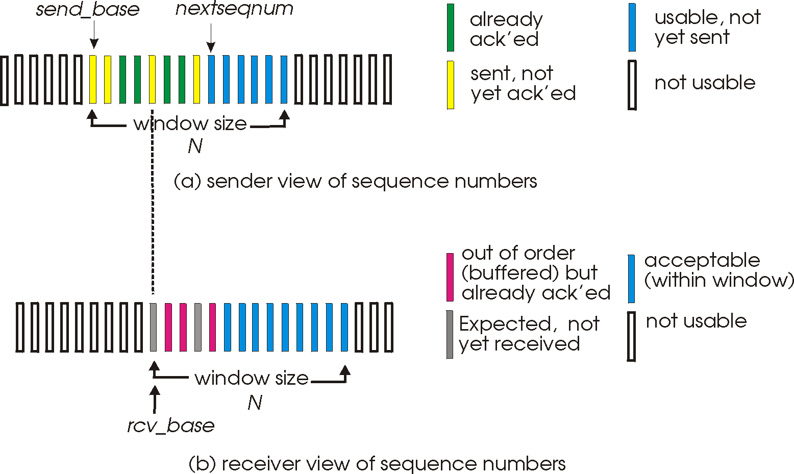
Selective Repeat

Slide 30
SR: Sender
Send Data From Above
If next available seq # in window
send pkt_{n}
Timeout_{n}
Resend pkt_{n}
Restart timer_{n}
Receive ACK_{n}
If in Send Window [sendbase, sendbase+n]
Mark pkt_{n} as received
If n smallest unACKed pkt
Advance window base to next unACKed seq #

Slide 31
SR: Receiver
Receive pkt_{n} in [rcvbase, rcvbase+n-1]
If out-of-order
Buffer pkt_{n}
If in-order
Deliver all in-order buffered pkts
Advance window to next not-yet-received pkt
Receive pkt_{n} in in [rcvbase-n, rcvbase-1]
Send ACK_{n}
Otherwise
Ignore

Slide 32
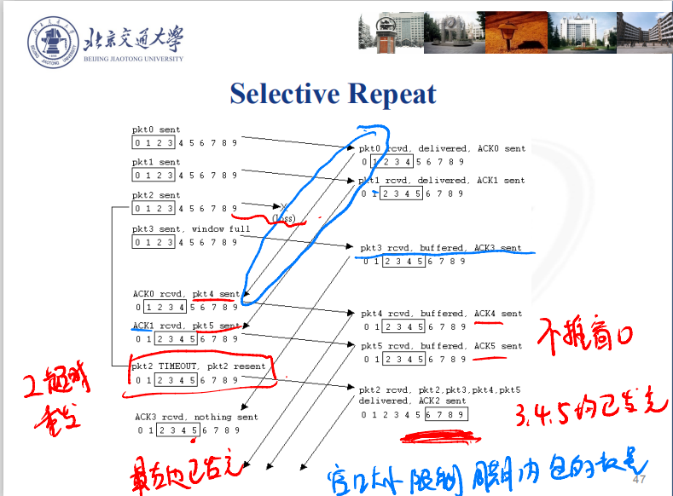
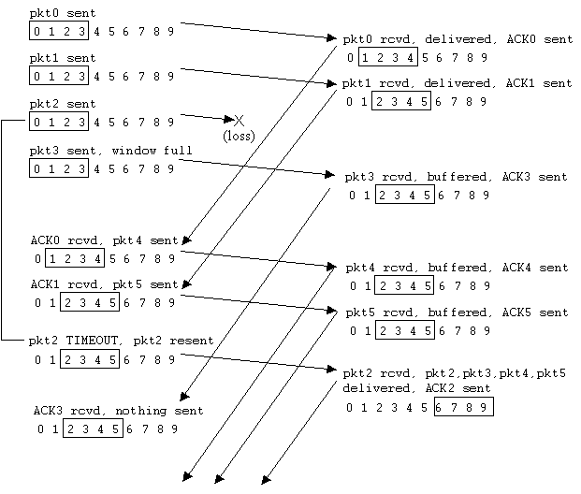
Selective Repeat

Slide 33
Contents
Transport Service
Elements of Transport Protocols
Internet Protocols – UDP
Internet Protocols – TCP
Congestion Control

Slide 34
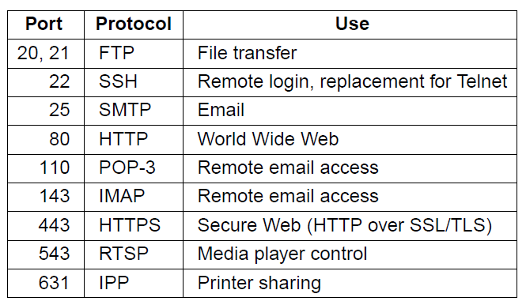
The TCP Service Model
TCP (Transmission Control Protocol) provides applications with a reliable byte stream between processes; it is the workhorse of the Internet
Popular servers run on well-known ports

Slide 35
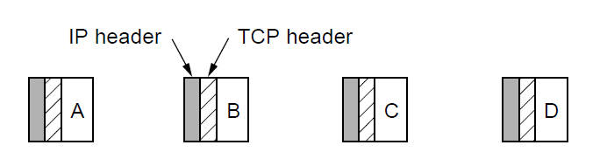
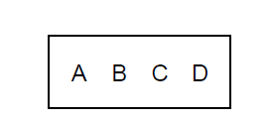
The TCP Service Model
Applications using TCP see only the byte stream [right] and not the segments [left] sent as separate IP packets
2048 bytes of data delivered to application in a single READ call
Four segments, each with 512 bytes of data and carried in an IP packet

Slide 36
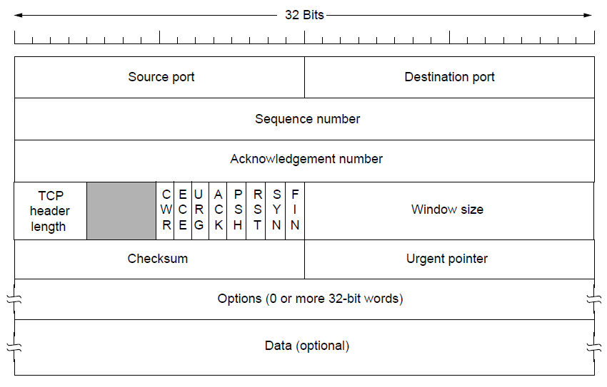
The TCP Segment Header
TCP header includes addressing (ports), sliding window (seq. / ack. number), flow control (window), error control (checksum) and more.
Notes:
The flags say what kind of segment it is, e.g., SYN for a connection establishment (synchronize) segment. The ack. number is a cumulative acknowledgement that means all data up to that number has been received. After the fixed part can come options.

Slide 37
Connection Establishment
Both sender and receiver must be ready before we start the transfer of data
– Need to agree on a set of parameters
– e.g., the Maximum Segment Size (MSS)
This is signaling
– It sets up state at the endpoints
– Like “dialing” for a telephone call

Slide 38
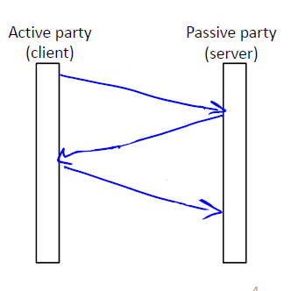
Three-Way Handshake
Used in TCP; opens connection for data in both directions
Each side probes the other with a fresh Initial Sequence Number (ISN)
– Sends on a SYNchronize segment
– Echo on an ACKnowledge segment
Chosen to be robust even
against delayed duplicates

Slide 39
Three-Way Handshake
Three steps:
– Client sends SYN(x)
– Server replies with SYN(y)ACK(x+1)
– Client replies with ACK(y+1)
– SYNs are retransmitted if lost
Sequence and ACK numbers carried on further segments

Slide 40
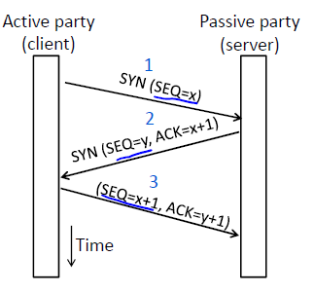
Three-Way Handshake
Client sends SYN(x)
Server replies with SYN(y)ACK(x+1)
Client replies with ACK(y+1)

Slide 41
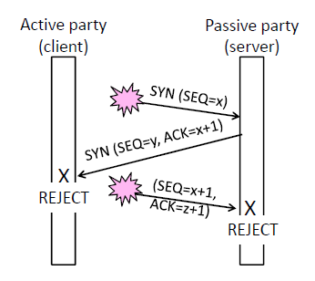
Three-Way Handshake
Suppose delayed, duplicate copies of the SYN and ACK arrive at the server!
Connection will be cleanly rejected on both sides ☺

Slide 42
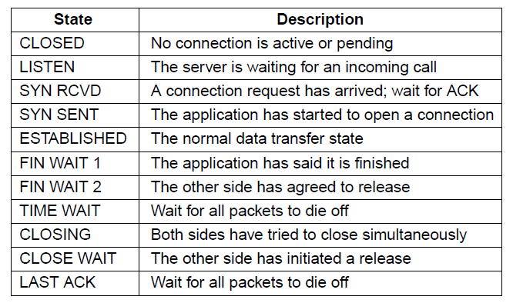
Three-Way Handshake
The TCP connection finite state machine has more states than our simple example from earlier.

Slide 43
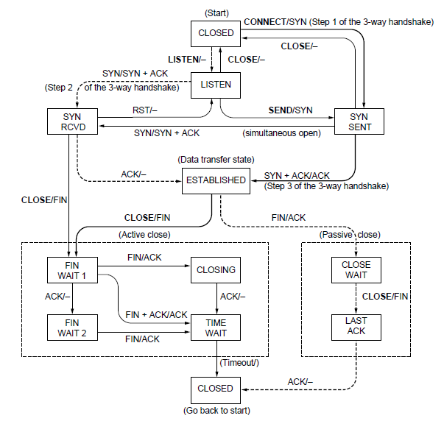
Three-Way Handshake
Solid line is the normal path for a client.
Dashed line is the normal path for a server.
Light lines are unusual events.
Transitions are labeled by the cause and action, separated by a slash.

Slide 44
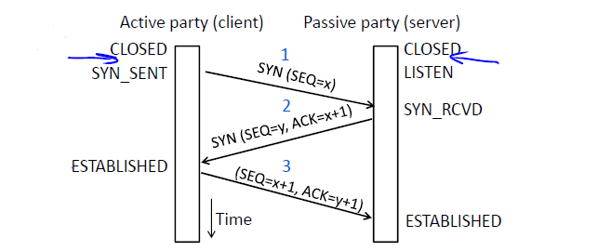
Three-Way Handshake
With the States

Slide 45
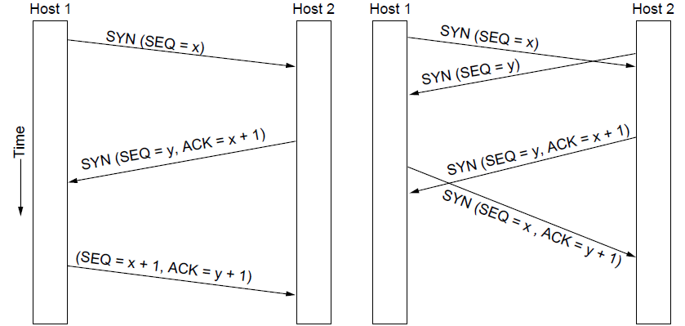
Three-Way Handshake
Finite state machines are a useful tool to specify and check the handling of all cases that may occur
TCP allows for simultaneous open
– i.e., both sides open at once instead of the client-server pattern
Normal case
Simultaneous connect

Slide 46
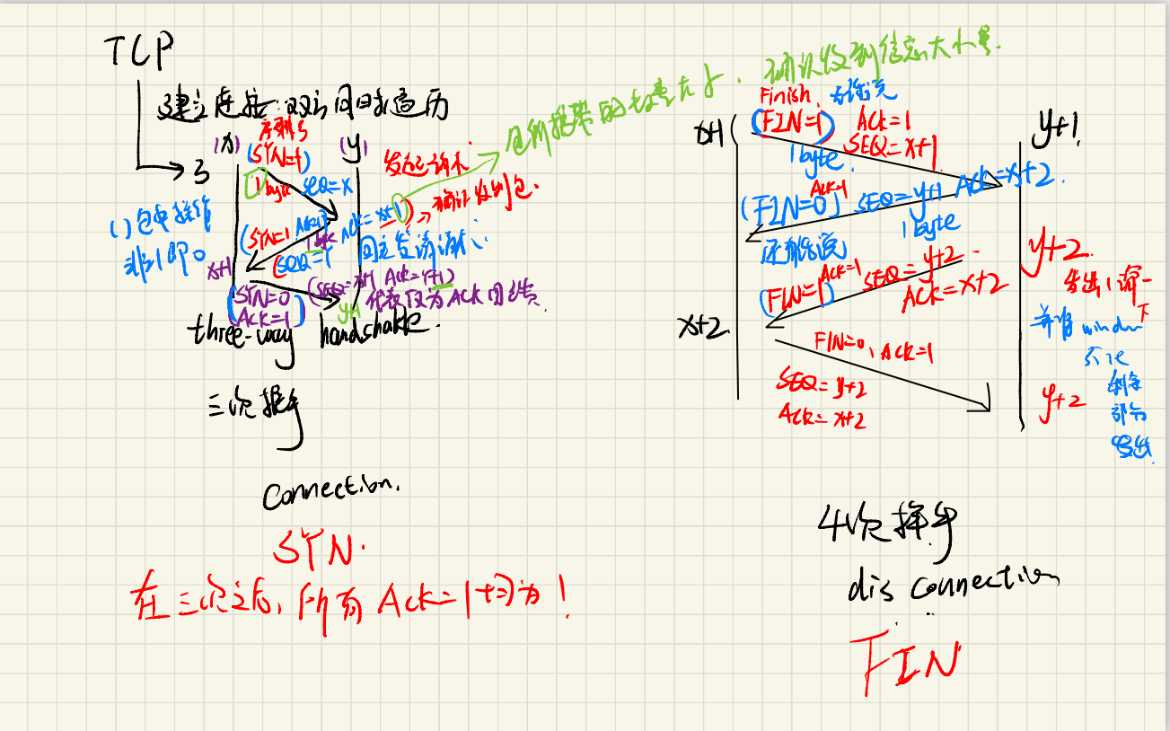

Slide 47
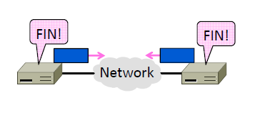
Connection Release
How to release connections
– We’ll see how TCP does it

Slide 48
Connection Release
Orderly release by both parties when done
– Delivers all pending data and “hangs up”
– Cleans up state in sender and receiver
Key problem is to provide reliability while releasing
– TCP uses a “symmetric” close in which both sides shutdown independently

Slide 49
Connection Release
Key problem is to ensure reliability while releasing
Asymmetric release (when one side breaks connection) is abrupt and may lose data

Slide 50
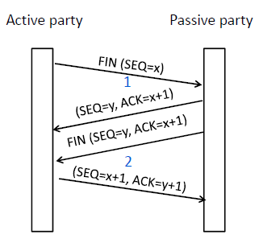
Connection Release
Two steps:
Active sends FIN(x), passive ACKs
Passive sends FIN(y), active ACKs
FINs are retransmitted if lost
Each FIN/ACK closes one direction of data transfer

Slide 51
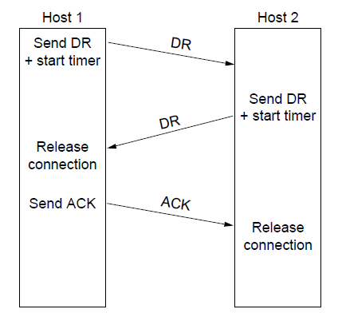
Connection Release
Normal release sequence, initiated by transport user on Host 1
DR=Disconnect Request
Both DRs are ACKed by the other side

Slide 52
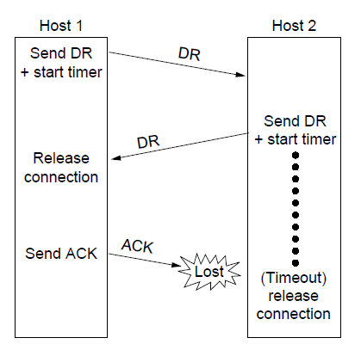
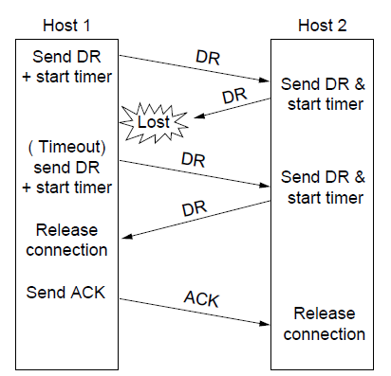
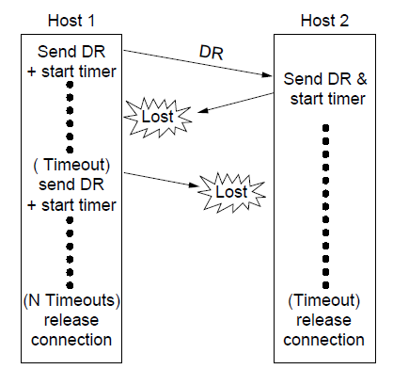
Connection Release
Final ACK lost, Host 2 times out
Lost DR causes retransmissions
Extreme: Many lost DRs cause both hosts to timeout

Slide 53
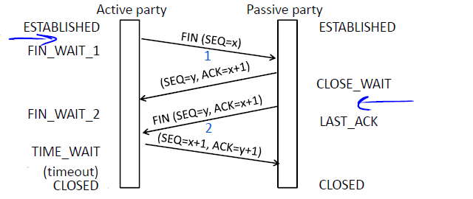
Connection Release
Again, with states …

Slide 54
Timeouts Problems
Timeout should be “just right”
– Too long wastes network capacity
– Too short leads to spurious resends
– But what is “just right”?
Easy to set on a LAN (Link)
– Short, fixed, predictable RTT (Round Trip Time)
Hard on the Internet (Transport)
– Wide range, variable RTT

Slide 55
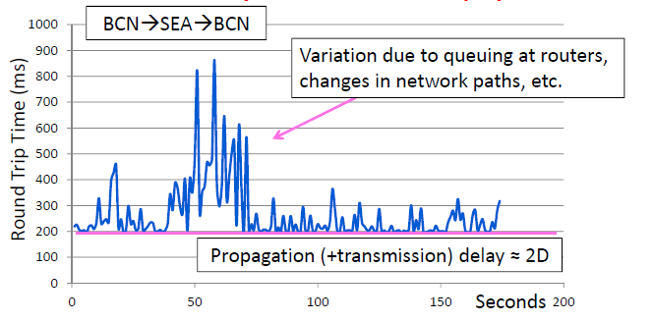
Example of RTT

Slide 56
Adaptive Timeout
Keep smoothed estimates of the RTT and variance in RTT
– Update estimates with a moving average
1. SRTTN+1 = 0.9*SRTTN + 0.1*RTTN+1
2. SvarN+1 = 0.9*SvarN + 0.1*|RTTN+1– SRTTN+1|
Set timeout to a multiple of estimates
– To estimate the upper RTT in practice
– TCP TimeoutN = SRTTN + 4*SvarN

Slide 57
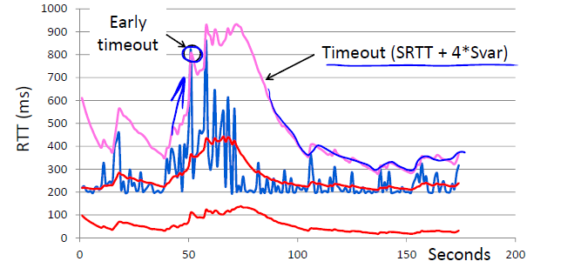
Adaptive Timeout

Slide 58
Adaptive Timeout
Simple to compute, does a good job of tracking actual RTT
– Little “headroom” to lower
– Yet very few early timeouts
Turns out to be important for good performance and robustness

Slide 59
TCP: Lost ACK
Host A
Host B
SendBase = 92
Seq=92, 8 bytes data
timeout
ACK=100
X
loss
Seq=92, 8 bytes data
ACK=100
SendBase = 100
time

Slide 60
TCP: Premature Timeout
Host A
Host B
SendBase = 92
Seq=92, 8 bytes data
Seq=100, 20 bytes data
Seq=92 timeout
ACK=100
ACK=120
Sendbase = 100
Seq=92, 8 bytes data
SendBase = 120
Seq=92 timeout
ACK=120
SendBase= 120
time

Slide 61
TCP: Cumulative ACK
Host A
Host B
SendBase= 92
Seq=92, 8 bytes data
ACK=100
timeout
Seq=100, 20 bytes data
X
loss
SendBase= 120
ACK=120
time

Slide 62
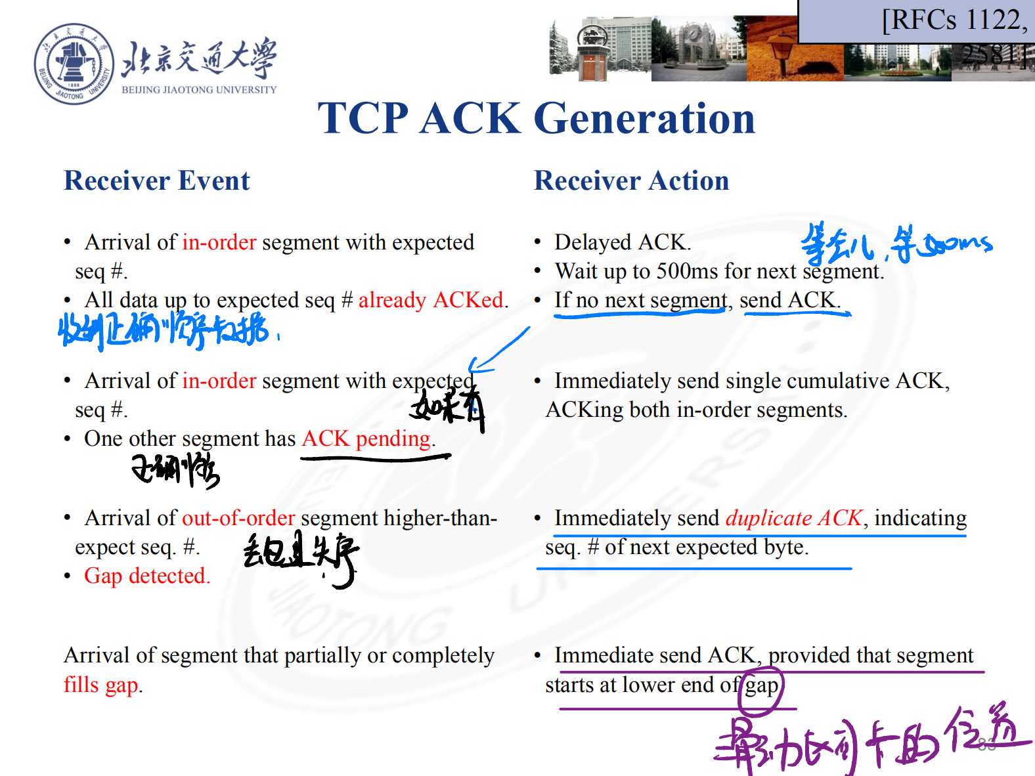
TCP ACK Generation
[RFCs 1122, 2581]
Receiver Event | Receiver Action
Arrival of in-order segment with expected seq #. All data up to expected seq # already ACKed. | Delayed ACK. Wait up to 500ms for next segment. If no next segment, send ACK.
Arrival of in-order segment with expected seq #. One other segment has ACK pending. | Immediately send single cumulative ACK, ACKing both in-order segments.
Arrival of out-of-order segment higher-than-expect seq. #. Gap detected. | Immediately send duplicate ACK, indicating seq. # of next expected byte.
Arrival of segment that partially or completely fills gap. | Immediate send ACK, provided that segment starts at lower end of gap.

Slide 63
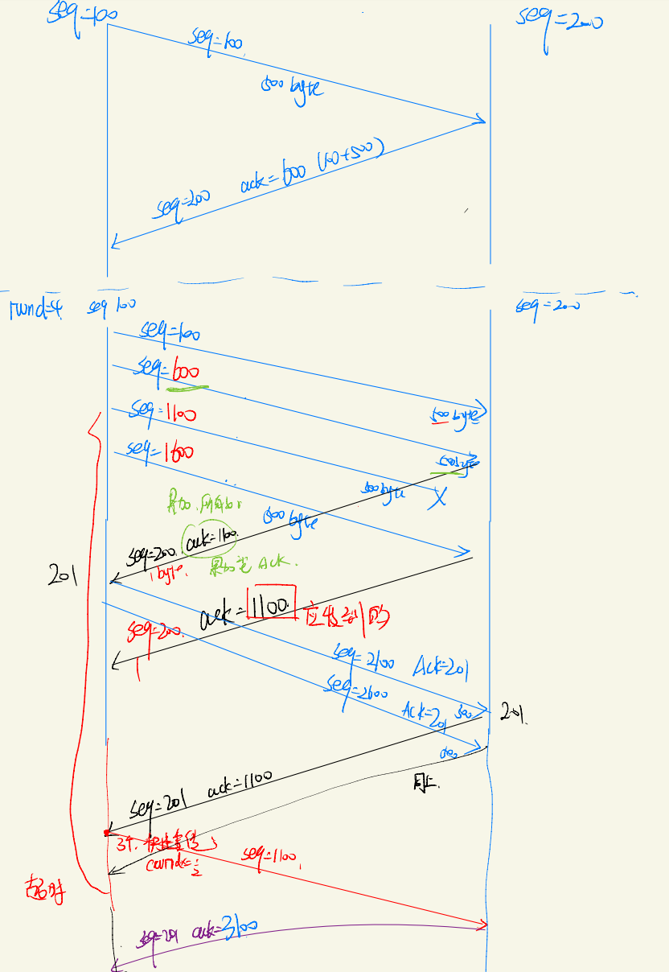

Slide 64
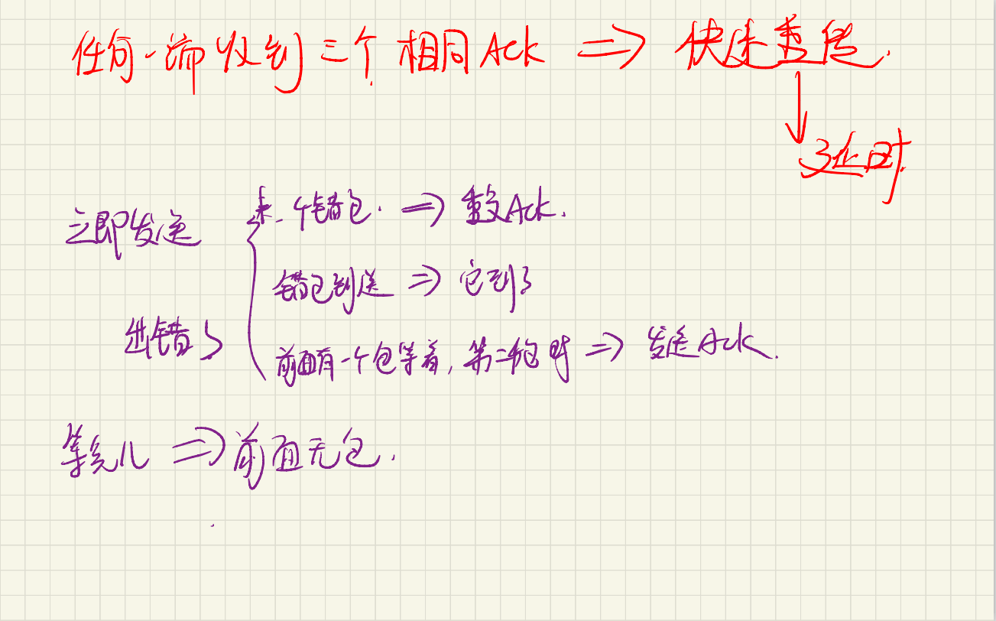

Slide 65
TCP Fast Retransmit
Problem
Timeout Period Long
Solution
Detect lost segments via duplicate ACKs.
Fast Retransmit
If 3 ACKs received assume the worst.
Resend segment before timer expires.

Slide 66
Host A
Host B
seq # 1
seq # 2
seq # 3
X
ACK 1
seq # 4
seq # 5
ACK 1
ACK 1
ACK 1
triple
duplicate
ACKs
resend seq #2
timeout
time

Slide 67
TCP Slow Start
Host A
Host B
Initially
cwnd = 1 MSS
Slow Start
Double cwnd every RTT
Until Loss Event or Threshold
one segment
RTT
two segments
four segments
time

Slide 68
TCP Slow Start
ssthresh
cwnd threshold maintained by TCP
On Timeout
ssthresh = cwnd/2
When cwnd >= ssthresh
Congestion Avoidance

Slide 69
AIMD
________ Increase ________ Decrease
ACKs Received
?
Loss Event (non-timeout-detected loss)
?

Slide 70
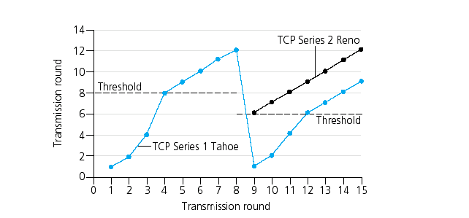
Popular “Flavors” of TCP
TCP Reno
cwnd window size
(in segments)
TCP Tahoe
Transmission Round

Slide 71
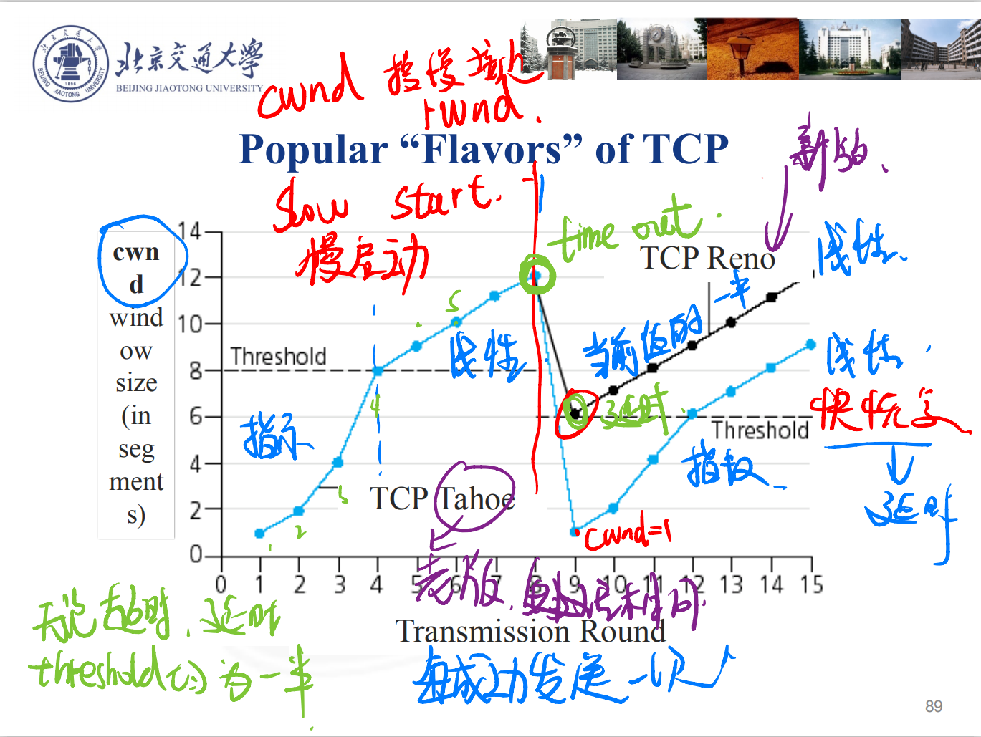

Slide 72
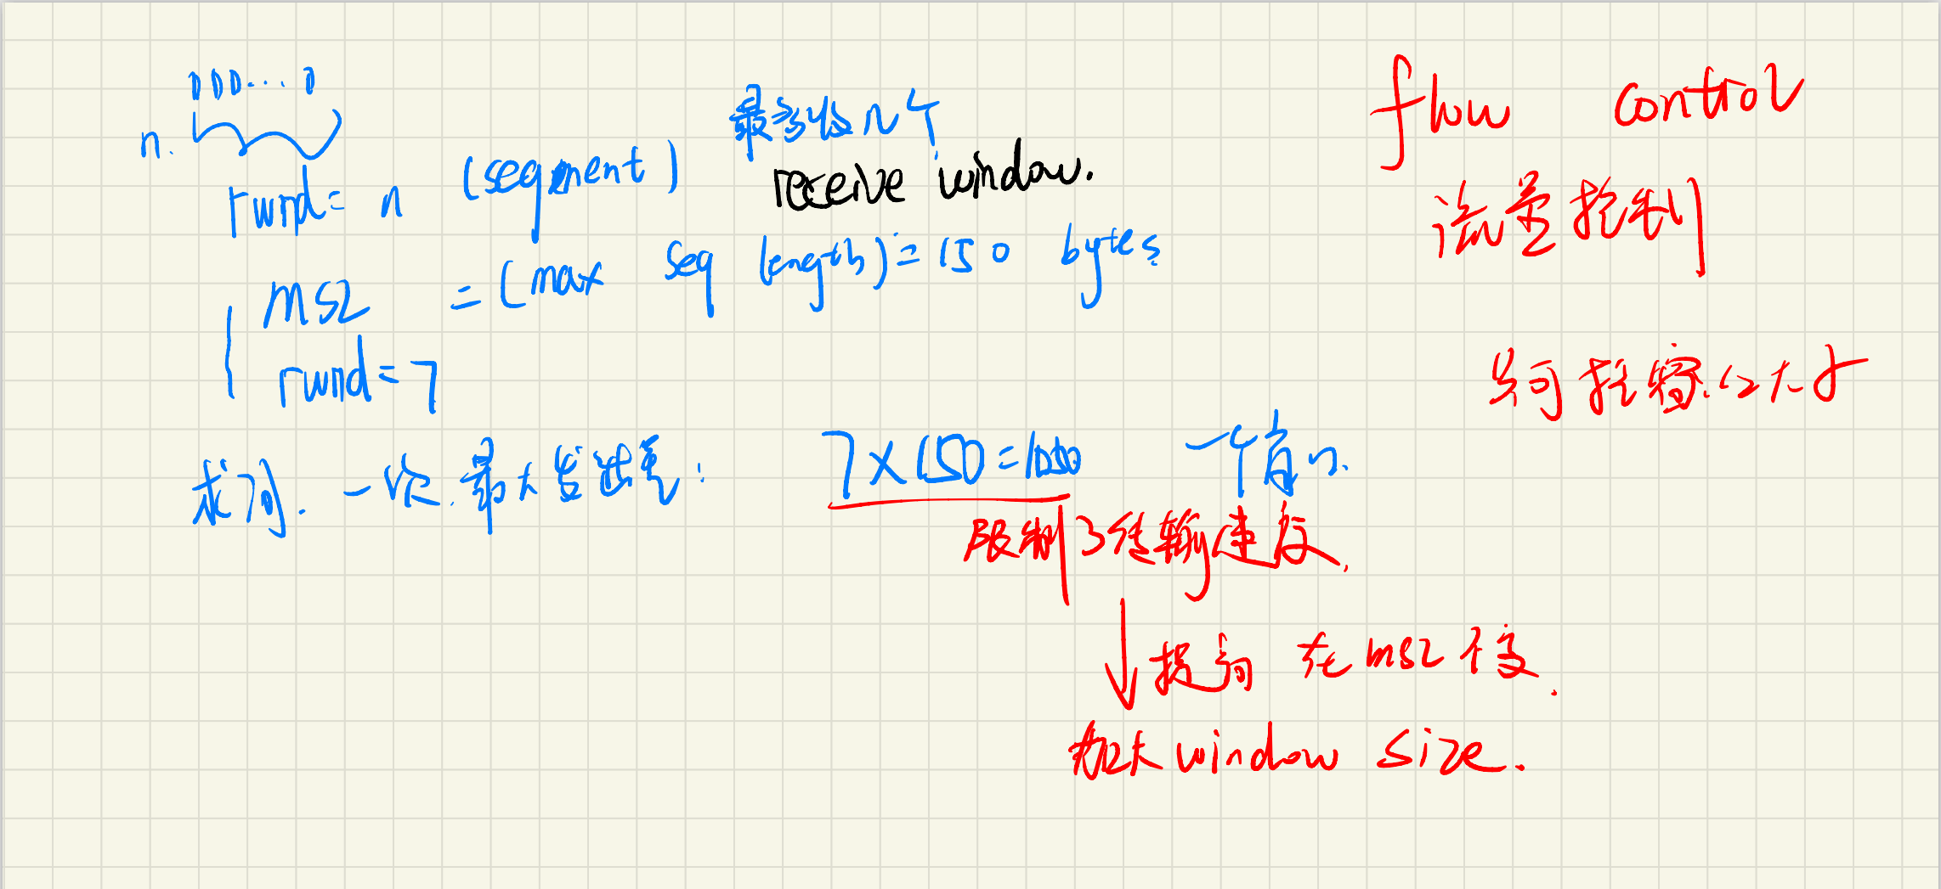

Slide 73


Slide 74


Slide 75


